Slide 1
Data clustering with k-means algorithm
Student’s name: thien quoc Nguyen
Applying program: information technology – master
Date: 21-08-2022

Slide 2
Table of contents
Machine Learning
Introduction
Supervised & Unsupervised learning
Project Description
Problem definition
Introduction to K-means algorithm
Installation & Testing
Clustering on Simulation data
Customers clustering using K-means
Conclusion
Evaluation methods and Applications

Slide 3


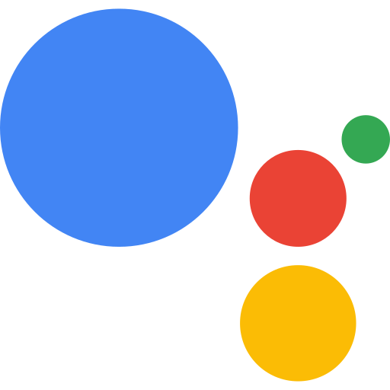


Machine learning > introduction
Notes:
Artificial Intelligence (AI) is creeping into every area of life that we may not realize in recent years:
You can see Self-driving cars from Google and Tesla
Or something you uses everyday like Apple’s Siri Virual Assistant, or if you are Team Google it is Google Assistant or Alexa.
Or something have made into history like Google Deepmind team with AlphaGo had beaten Korean’s world champion Lee Sedol
Those are just a few of the many applications of AI/Machine Learning.

Slide 4
Machine learning > introduction
Computer Program
Experience
E
Performance
P
Tasks
T

Slide 5
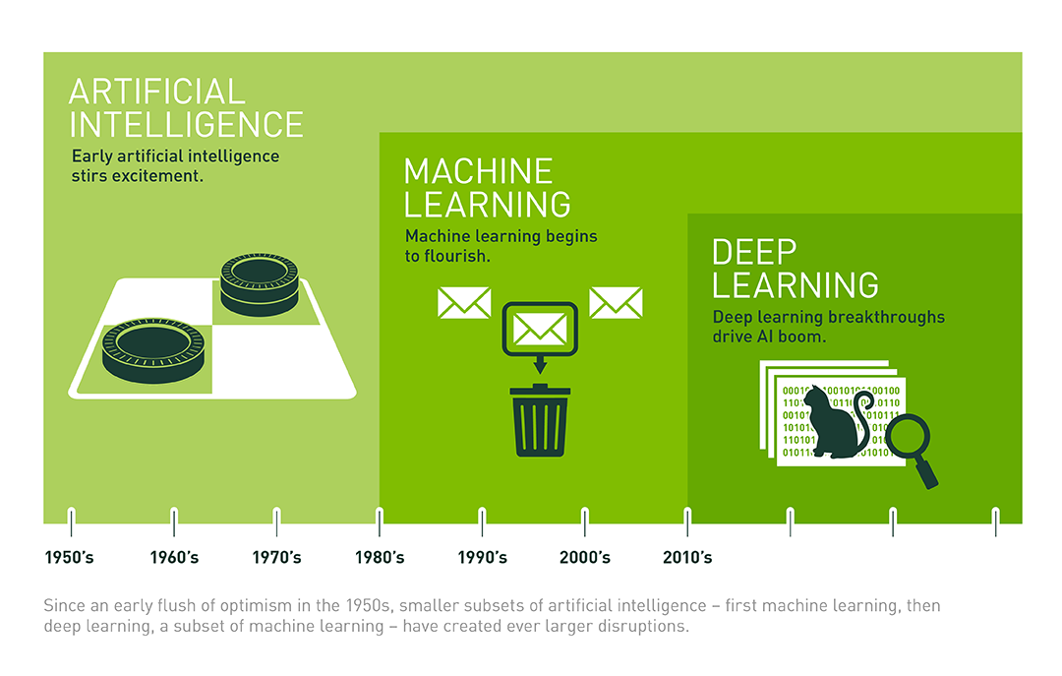
Machine learning > introduction

Slide 6
Machine learning > categories
Supervised Learning
Unsupervised Learning

Slide 7
Machine learning > common libraries
Numpy
Pandas
Scikit-learn
Matplotlib.pyplot

Slide 8
Project description > problem definition

Slide 9
Project description > introduction to k-means

Slide 10
Project description > evaluation methods & application

Slide 11
Installation and testing
Clustering on simulation data
Customer clustering using K-means

Slide 12
Installation and testing > conclusion

Slide 13
References
Thank you for your time!

